Slide 1

Analysis of Land Use and Land Cover (LULC) Changes at IIT Kanpur Campus
Group Members : ASHISH ARYAL, YUVRAJ SINGH, ARKA DIPTA SARKAR and HARSH CHANDRAKAR
Course Instructor : Dr. Bharat Lohani (CE671 : Introduction to Remote Sensing)

Slide 2

Introduction
The IIT Kanpur campus has undergone significant changes over the past two decades, including infrastructure expansion, increased green cover, and the development of new facilities. This analysis explores the relationship between educational development and environmental stewardship, demonstrating how an academic institution manages its land resources, adapts to changing infrastructure demands, and maintains ecological balance.
1
2
3
Objective
Methodology
Significance
To identify and characterize LULC changes over the IIT Kanpur campus over the past two decades.
Quantitative research using remote sensing data, GIS techniques, and advanced classification methods to quantify LULC changes, identify trends, and deduce environmental implications.
Understanding LULC dynamics will assist in sustainable campus planning and provide an example for similar institutions seeking to balance development with environmental conservation.

Slide 3
Methods and Methodology
The research utilizes remote sensing data, specifically Sentinel satellite imagery, to analyze LULC changes. The imagery is processed using GIS techniques and supervised classification methods, which involve training the algorithm to recognize different land cover types based on spectral signatures. The classification process categorizes pixels into four classes: forest, open land, buildings, and roads. Accuracy assessment is conducted using confusion matrices to evaluate the precision of the classification results.
Data Acquisition
Image Preprocessing
Sentinel satellite imagery with a spatial resolution of 10 meters , from Copernicus
The imagery is preprocessed to correct for atmospheric and geometric distortions, ensuring accurate analysis.
Classification
Accuracy Assessment
Supervised classification using Support Vector Machine Algorithm.
Confusion matrices, to evaluate the accuracy of the classification results, ensuring reliable analysis.

Slide 4
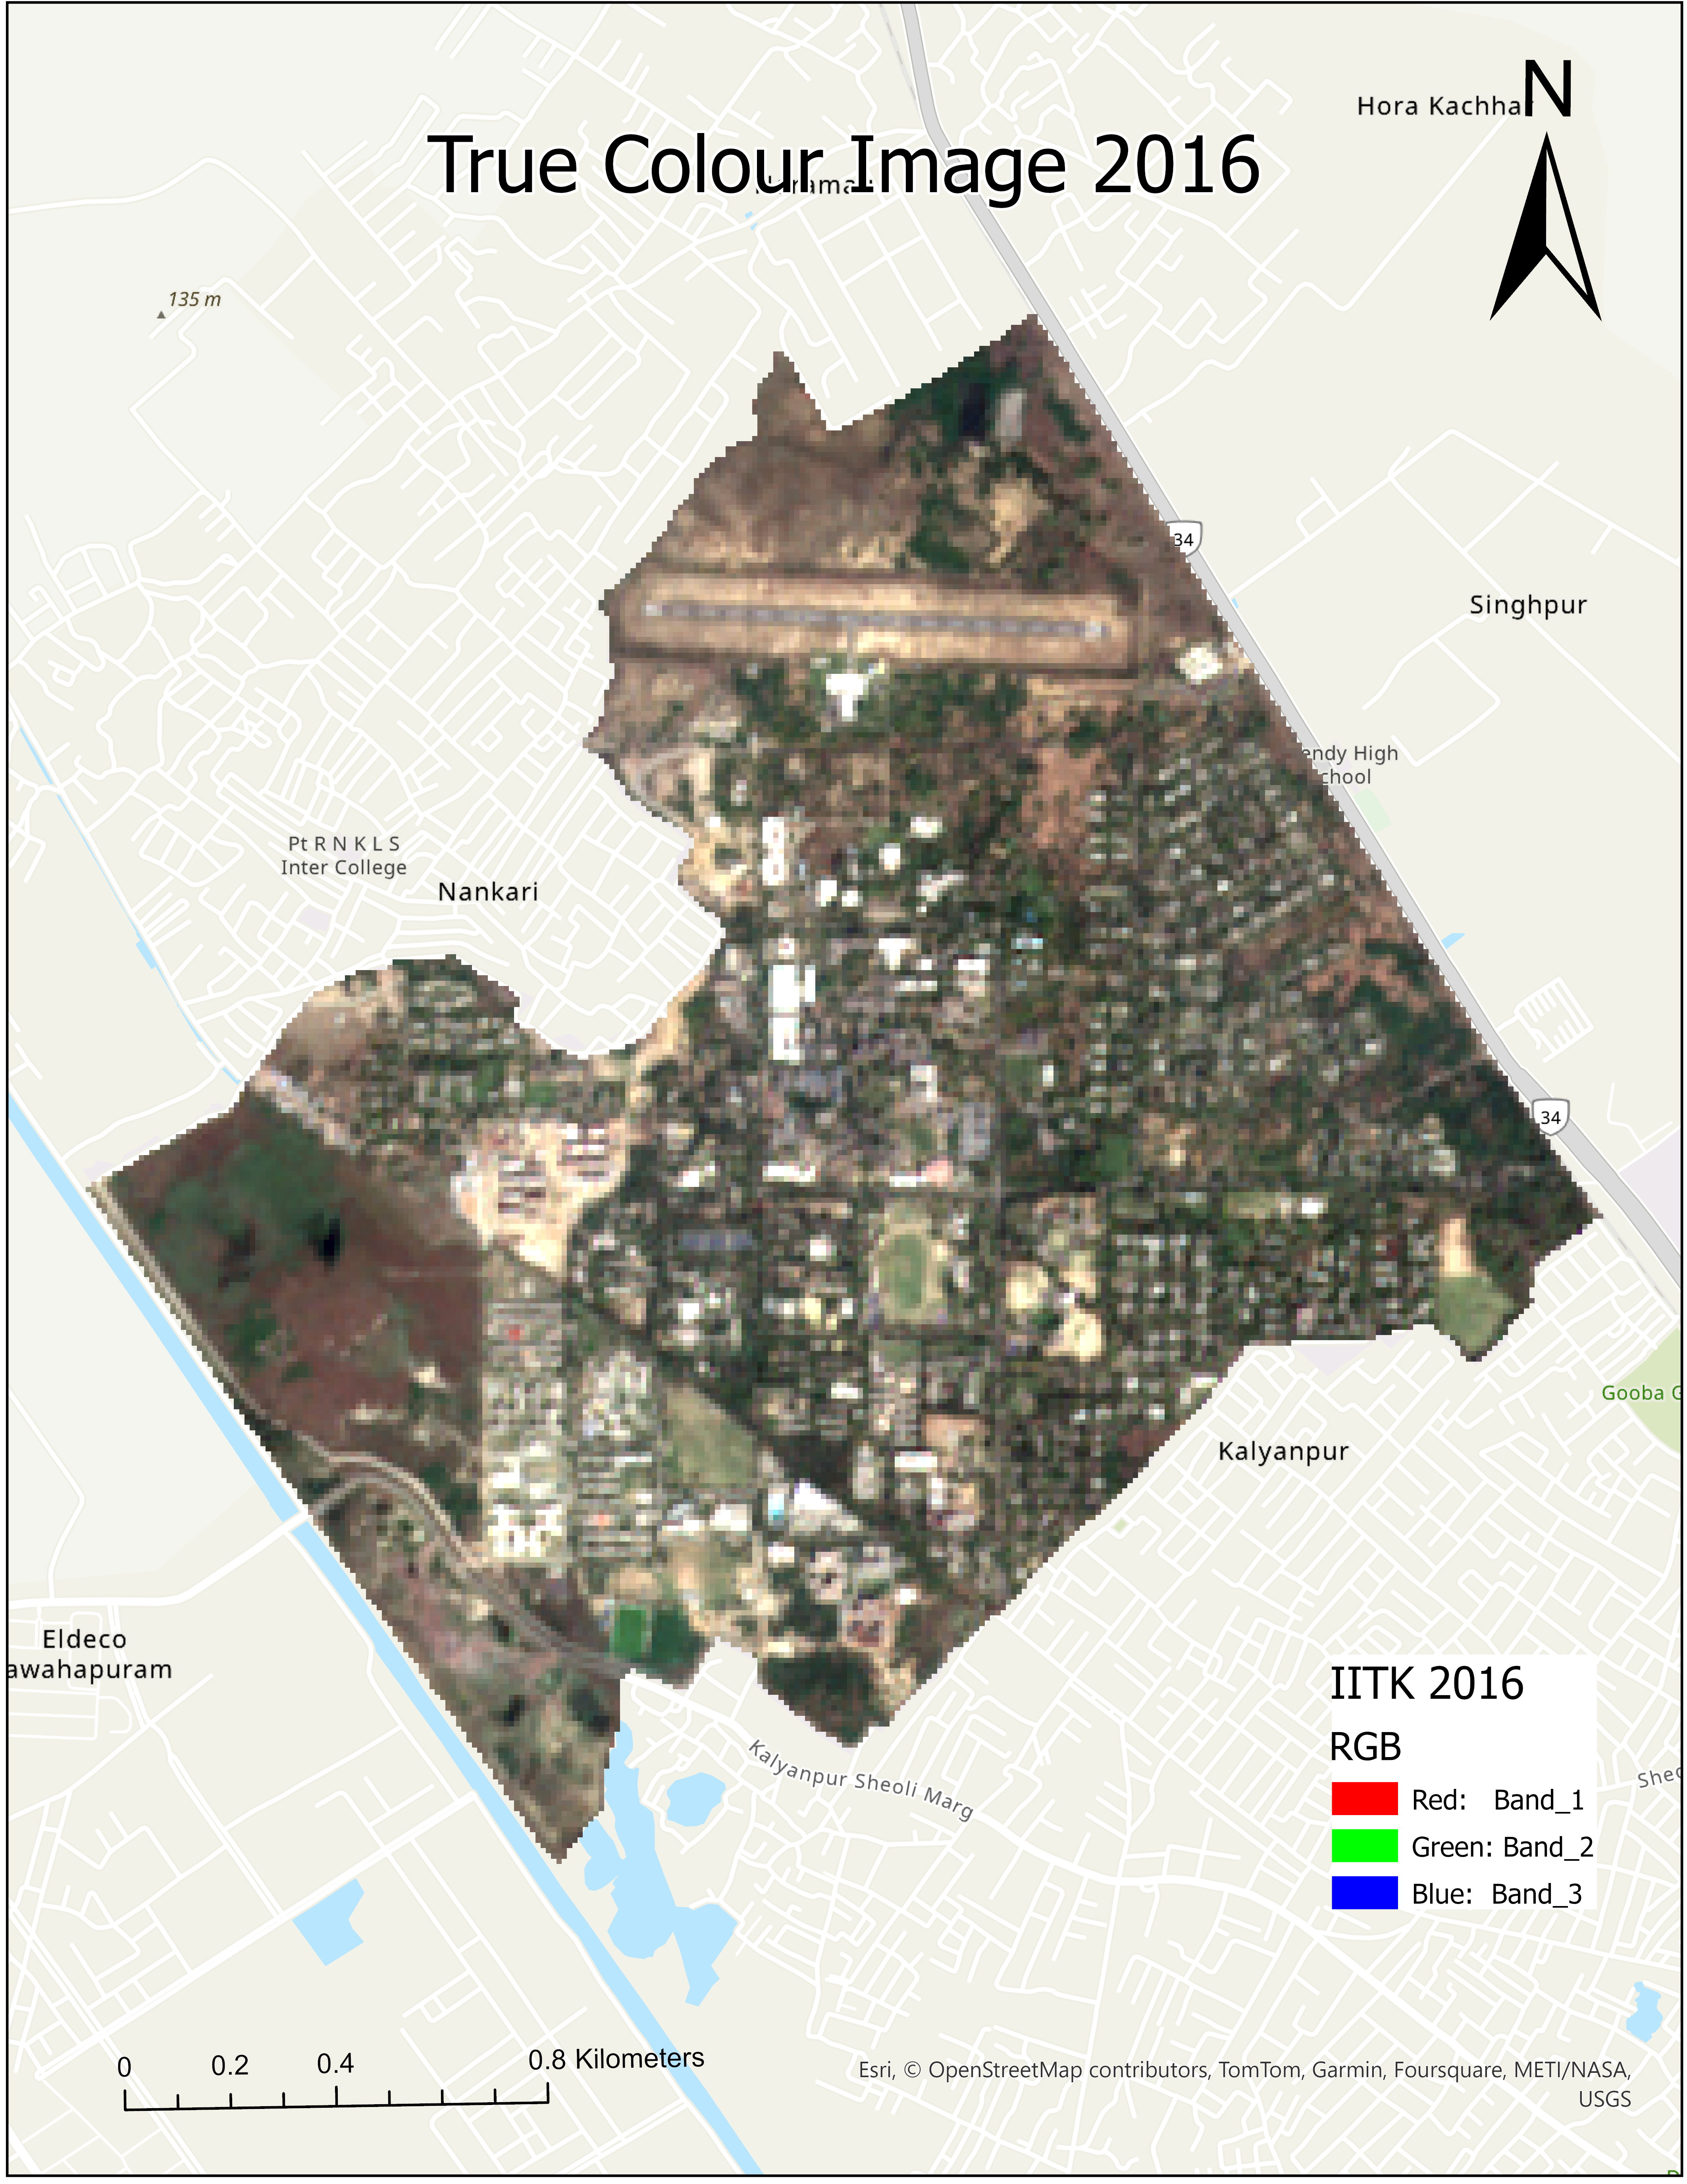
Sentinel Images
2016 Layout
The image shows the campus layout in 2016, with a mix of green areas, buildings, and roads.

Slide 5
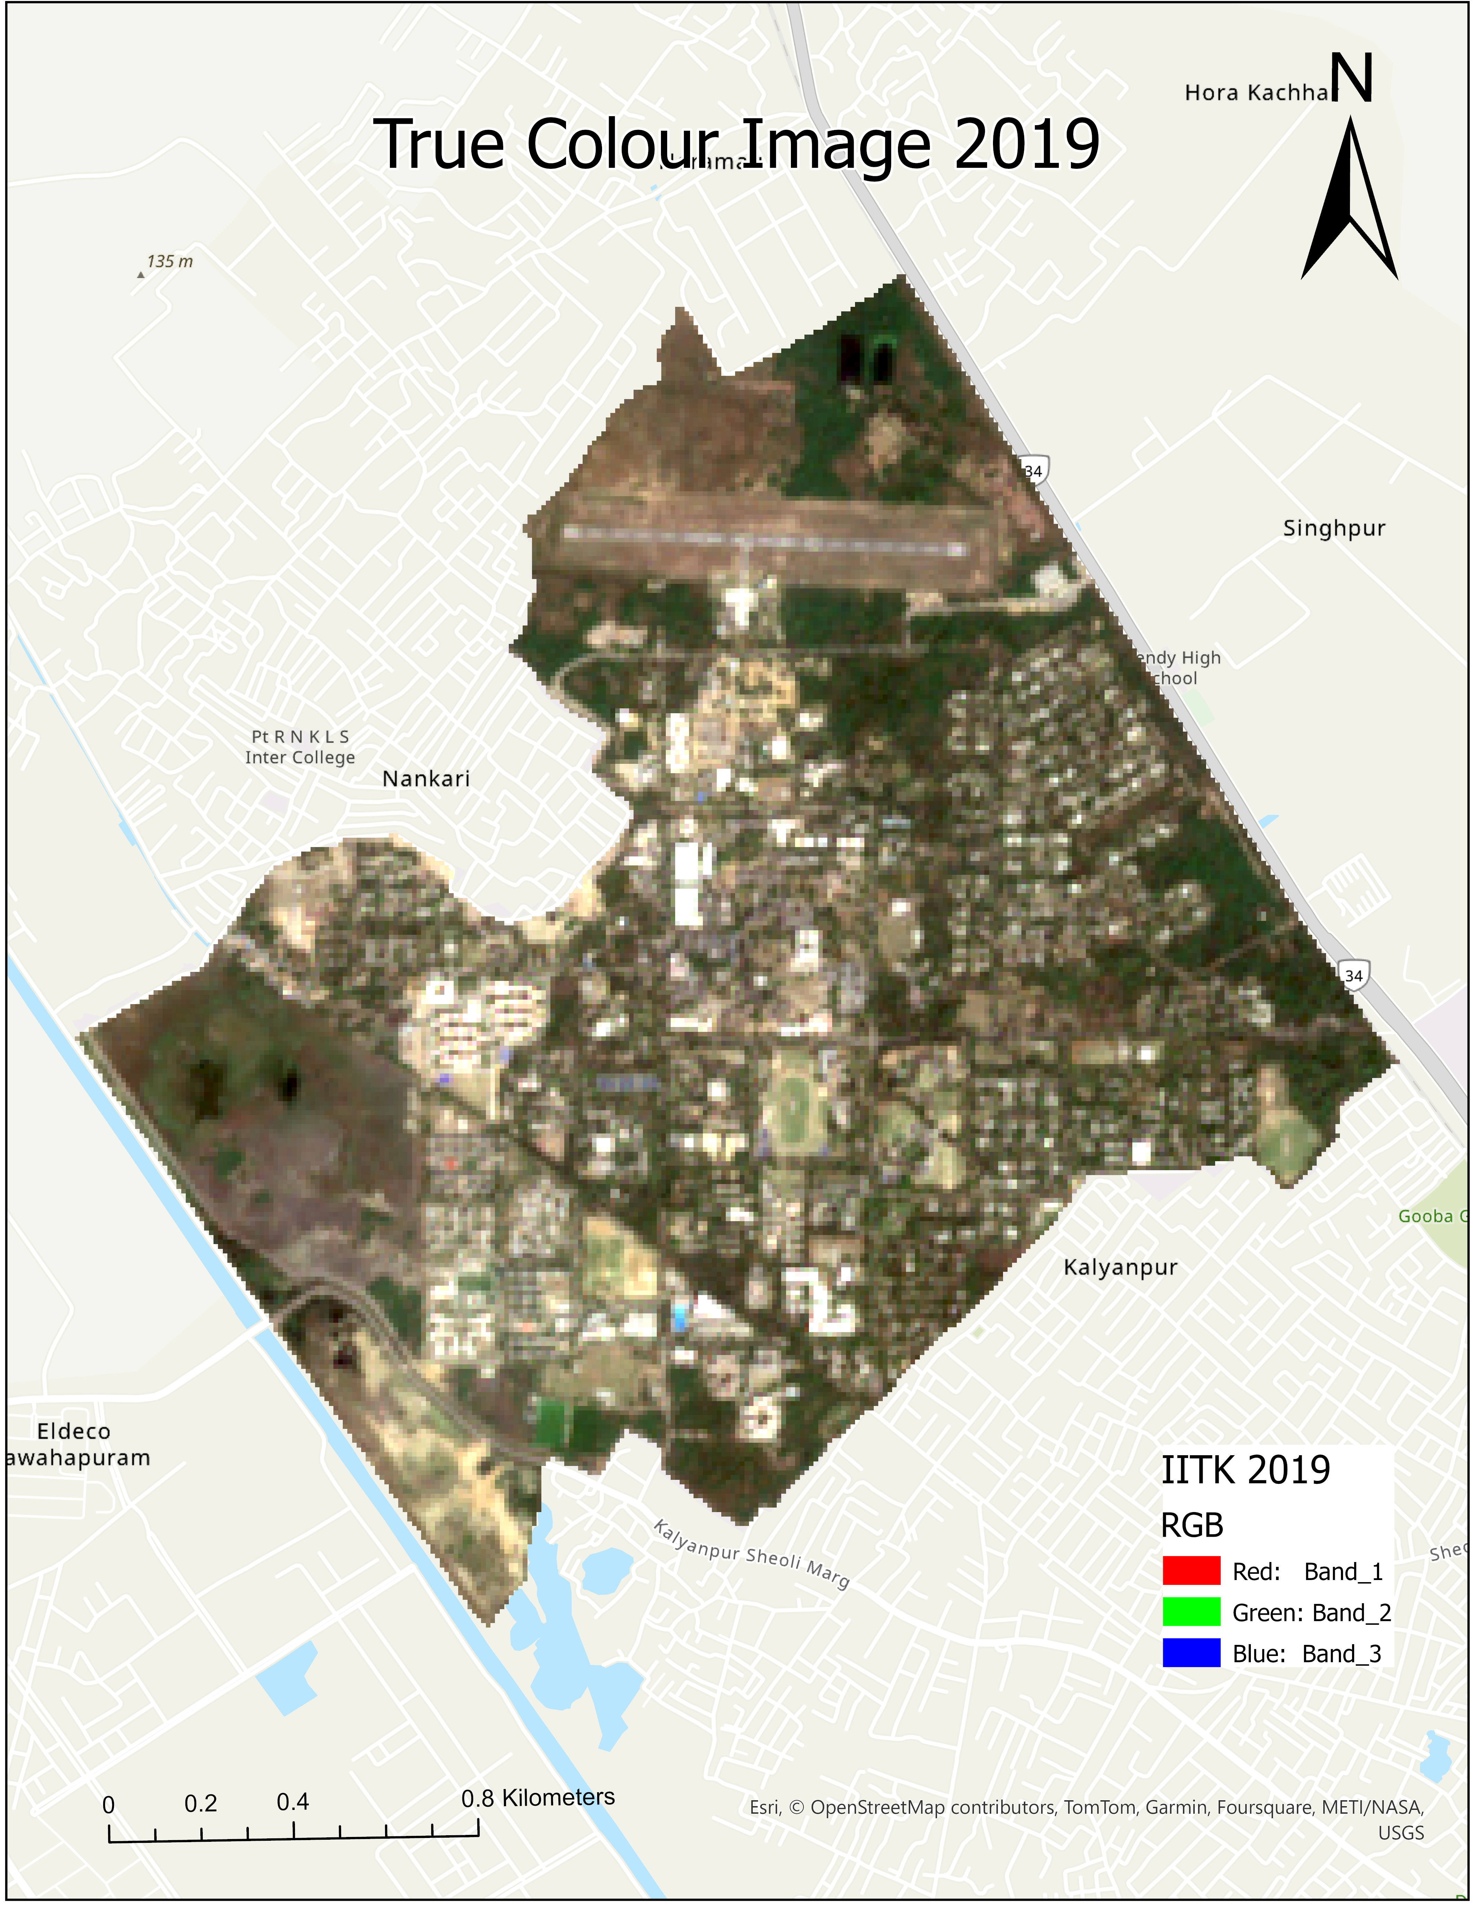
Sentinel Images
2019 Layout
The image shows the campus layout in 2019, with noticeable changes in land cover, including the expansion of buildings and infrastructure.

Slide 6
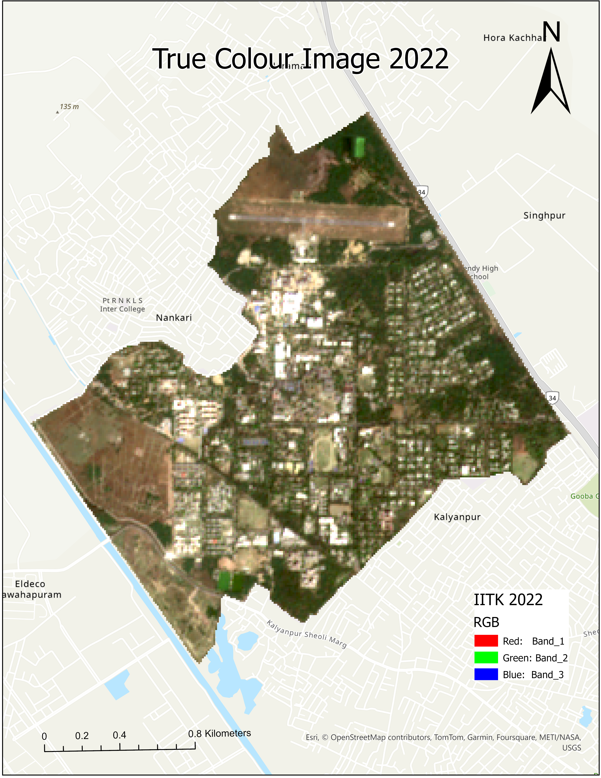
Sentinel Images
2022 Layout
The image shows the campus layout in 2022, with further changes in land cover, including the development of new facilities and the expansion of existing ones.

Slide 7
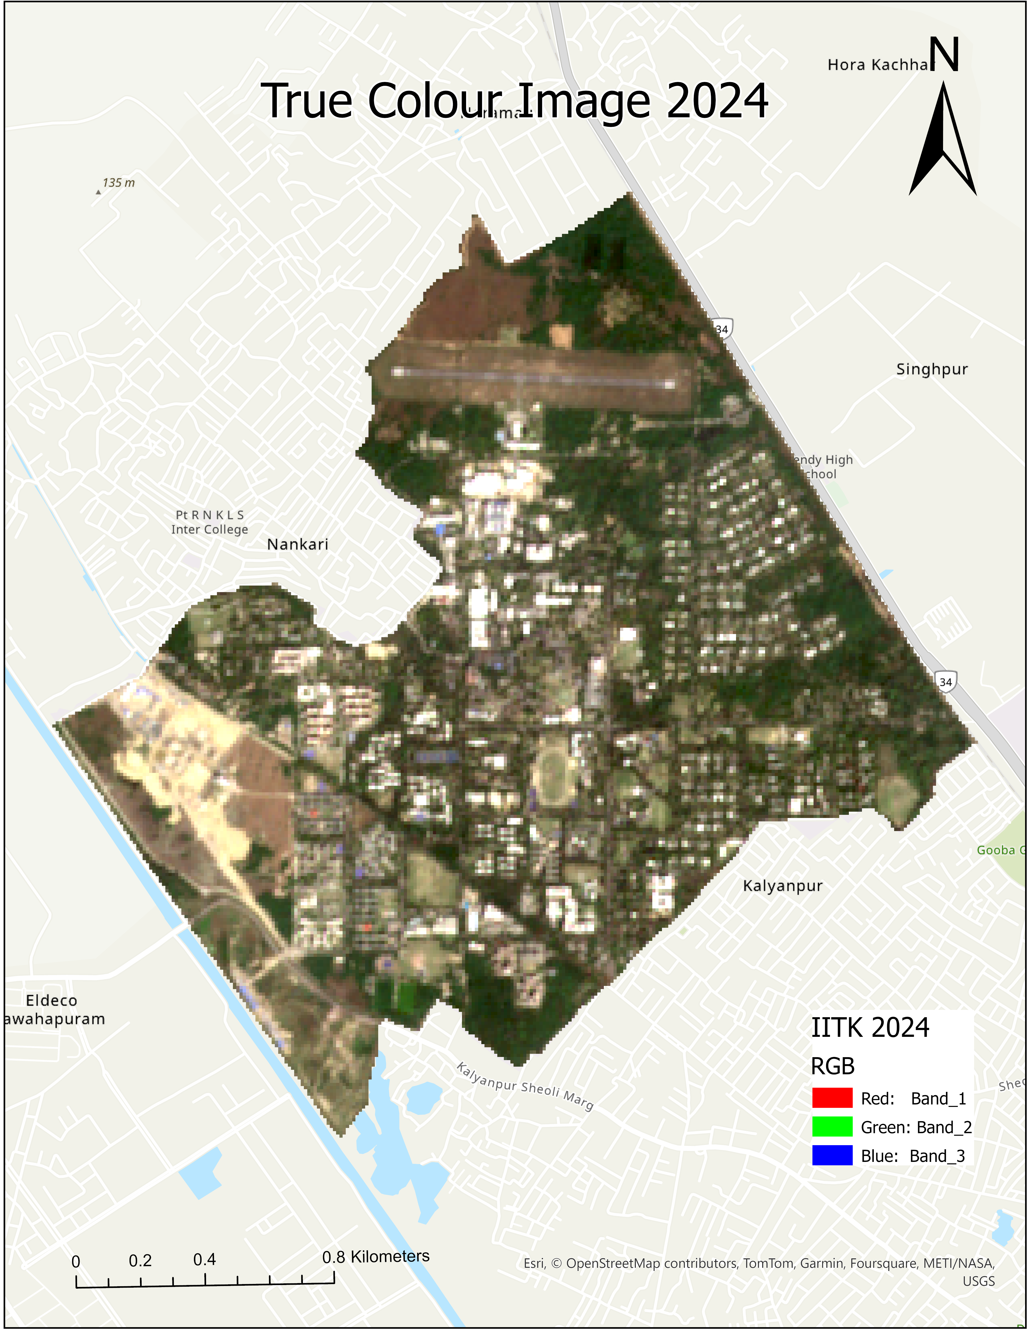
Sentinel Images
2024 Layout
The image shows the campus layout in 2024, with a mix of green areas, buildings, and roads.

Slide 8
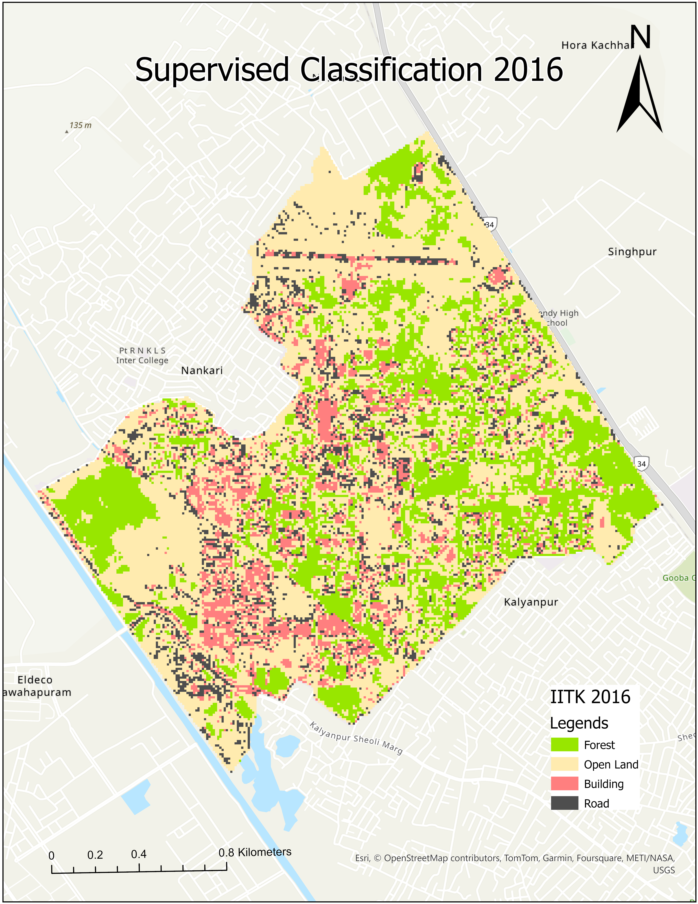
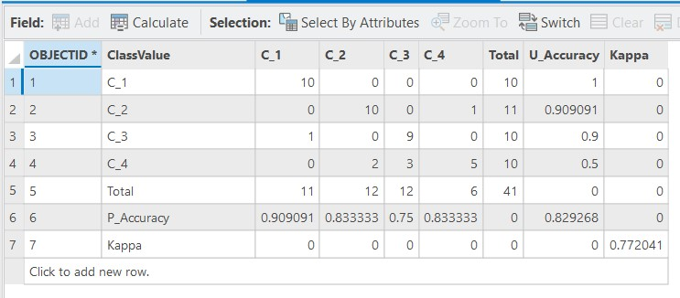
Classified Images
2016 Layout
The image shows the classified land cover types in 2016, with a mix of forest, open land, buildings, and roads.

Slide 9
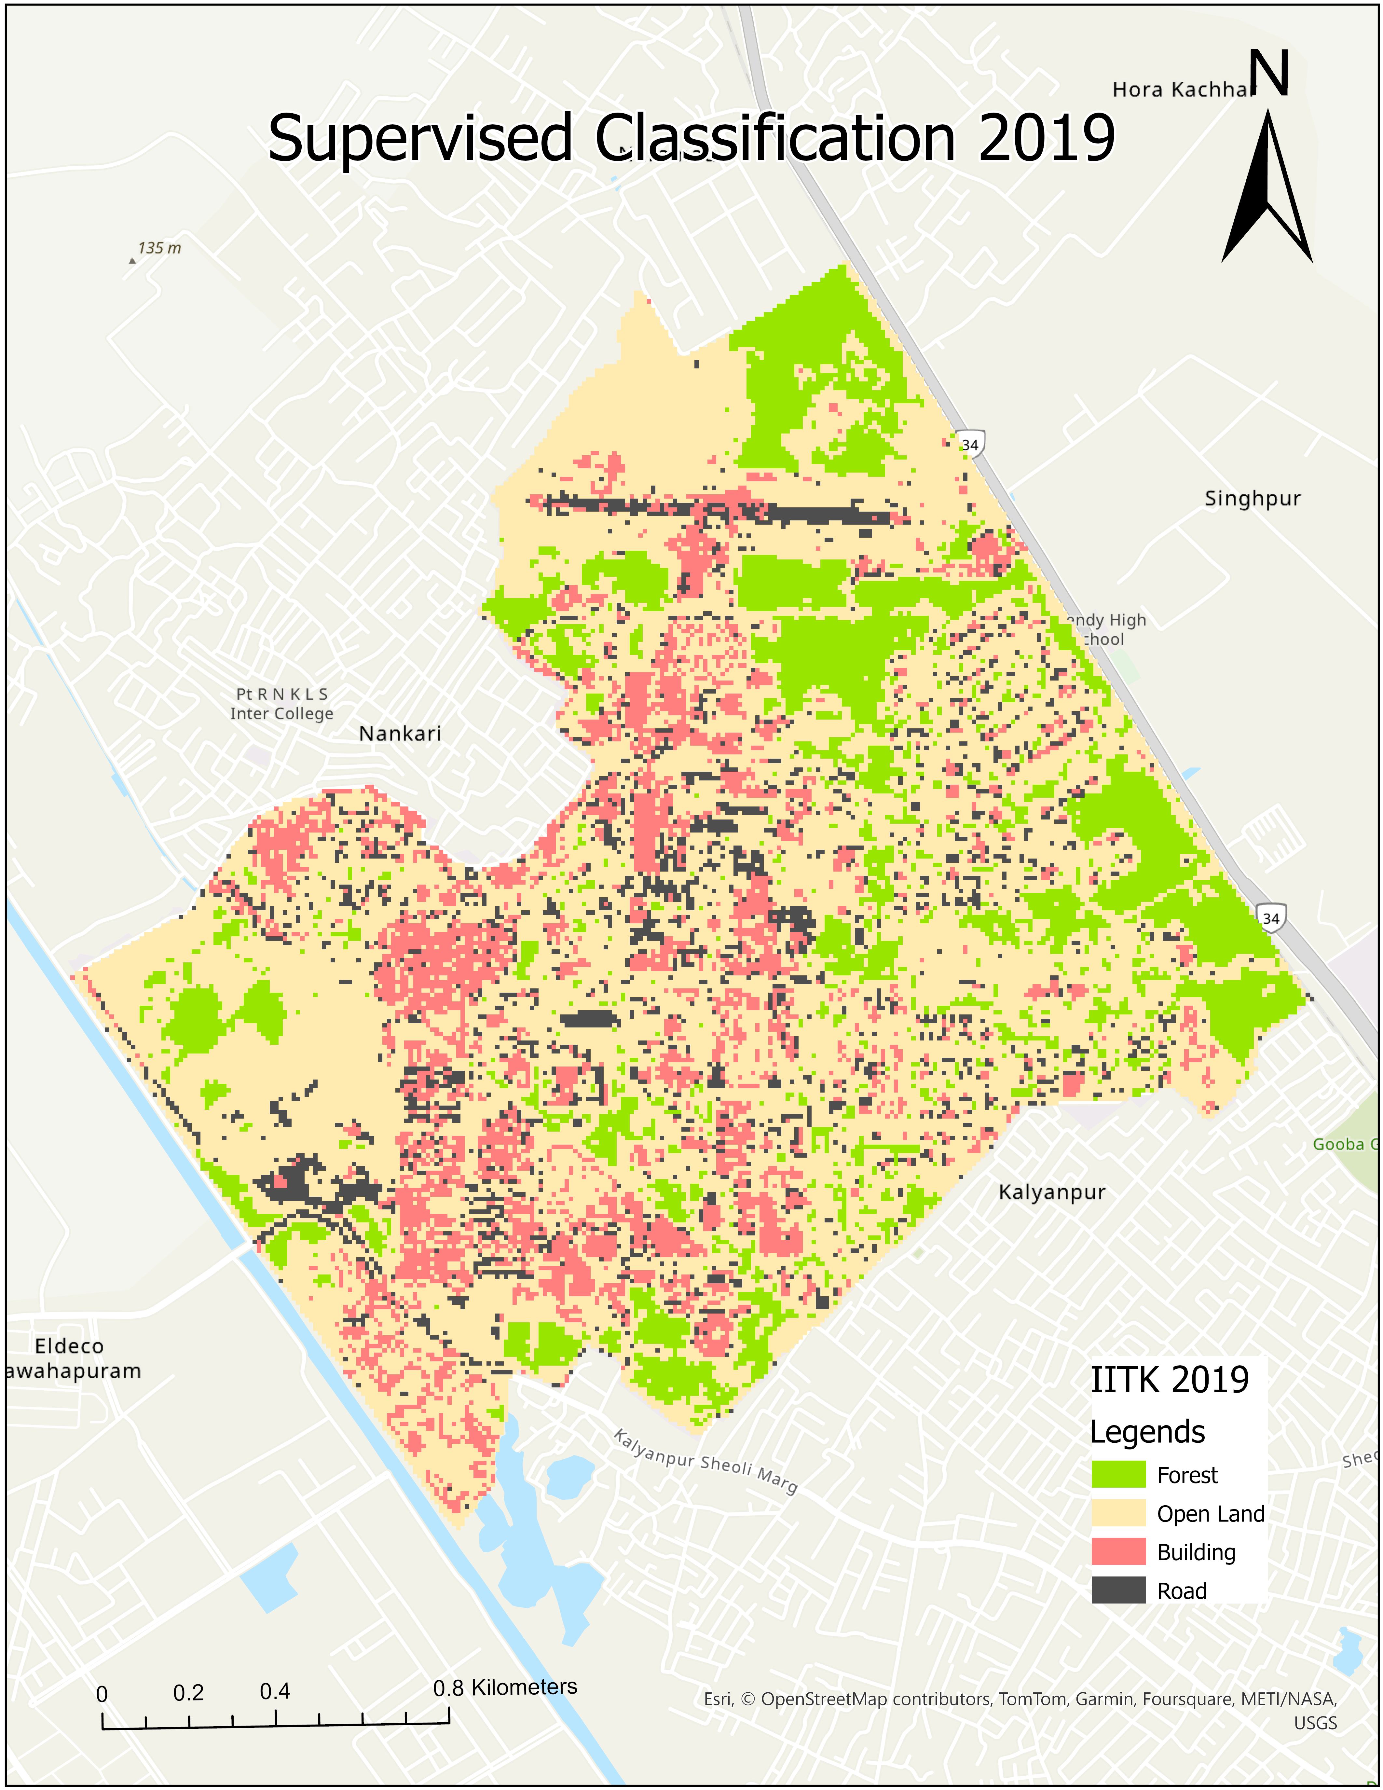
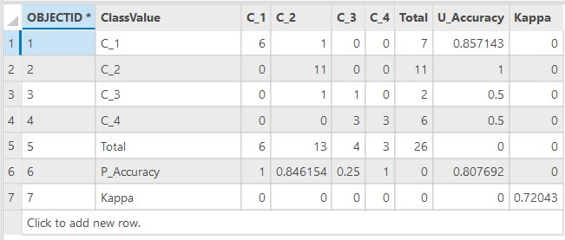
Classified Images
2019 Layout
The image shows the classified land cover types in 2016, with a mix of forest, open land, buildings, and roads.

Slide 10
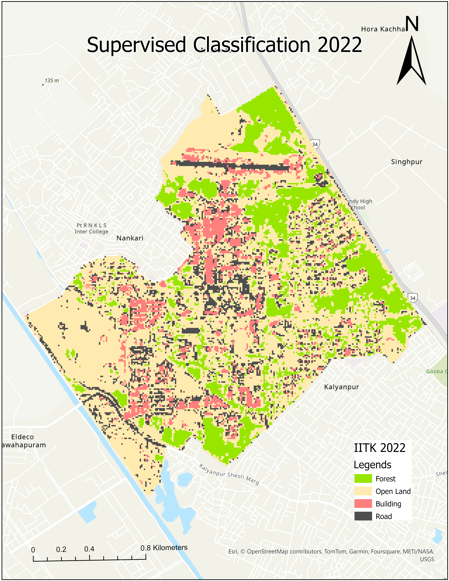
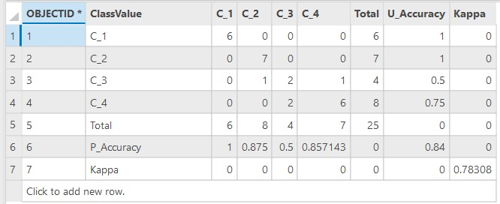
Classified Images
2019 Layout
The image shows the classified land cover types in 2016, with a mix of forest, open land, buildings, and roads.

Slide 11
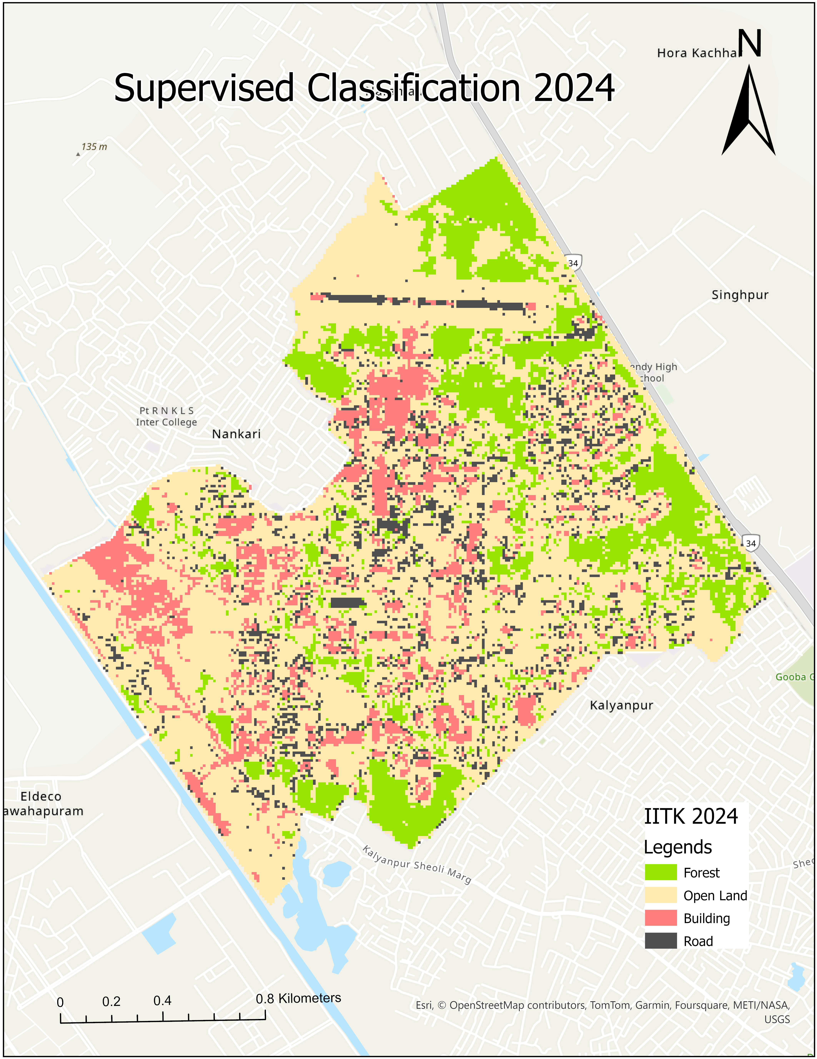
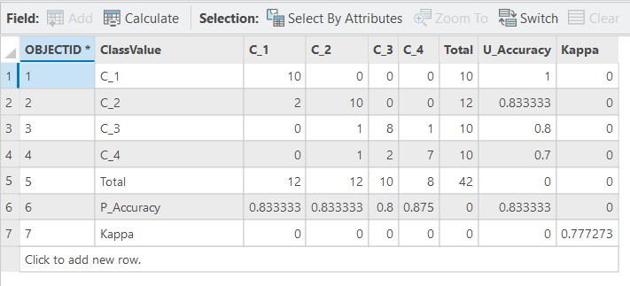
Classified Images
2019 Layout
The image shows the classified land cover types in 2016, with a mix of forest, open land, buildings, and roads.

Slide 13
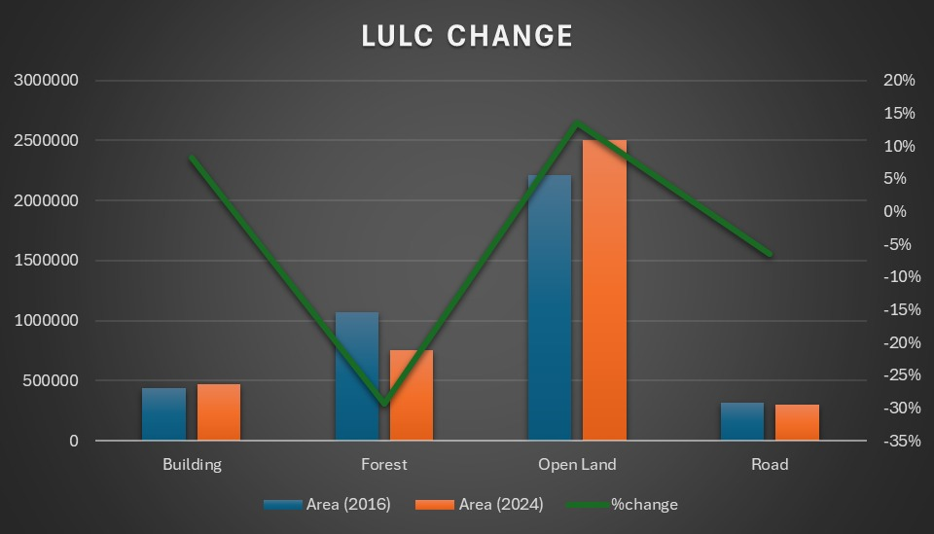

Slide 14
Results and Discussion
Roads : The analysis reveals a slight decrease in Roads.
Forest Cover
Open Land
Buildings
The analysis reveals a slight decrease in forest cover over the past two decades, indicating the impact of development on green spaces.
Open land areas have decreased significantly, indicating the expansion of buildings and infrastructure.
The area covered by buildings has increased significantly, reflecting the growth of the campus and its facilities.

Slide 15
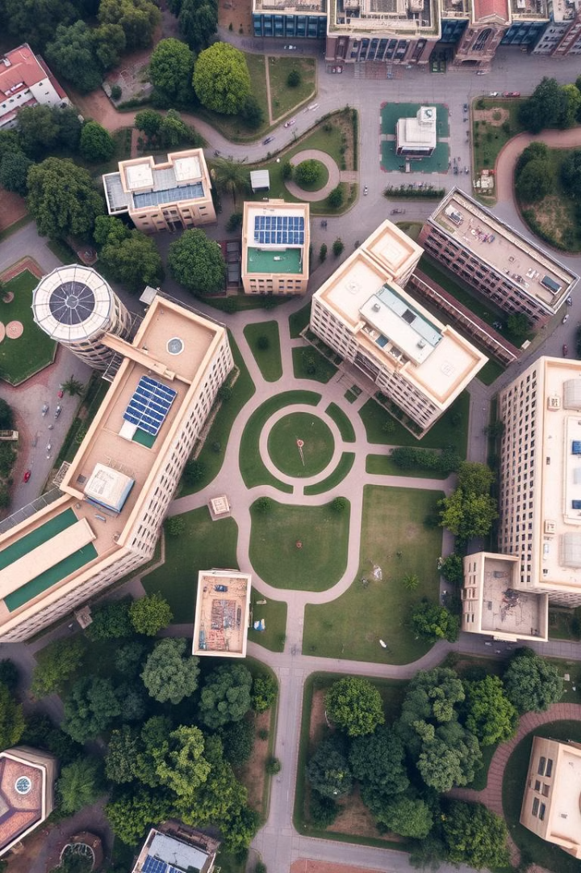
Conclusions
As per our Analysis total area of forest is decreased where as open-land and building area are increased. And road area also decreases but it seems impractical in real scenario. But there may be reasons that road side trees grown taller due to which more road gets covered.

Slide 16

References
[1]
Copernicus, Sentinel
[2]
ArcGIS Pro

Slide 17


